Slide 1

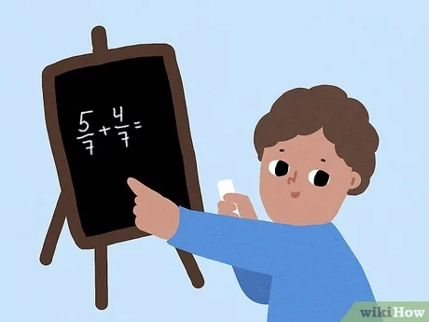
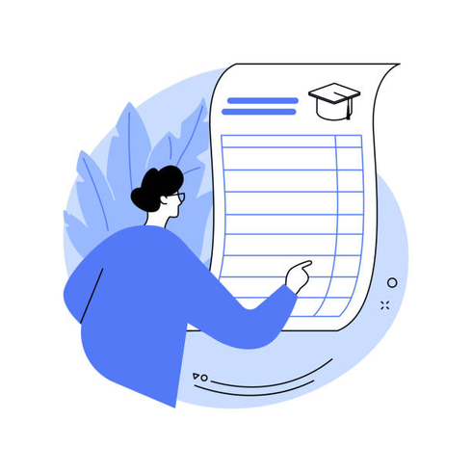
Intelligence ??
There is no clear definition of intelligence. (AI) is try to reproduce, or surpass, the
capabilities of humans and animals
01.
Existing solutions often struggle with the trade-off between dimensionality reduction and detection performance. This project seeks to address the following challenges
GPS to navigate the best route, performing complex tasks. First chess AI system (AlphaGo) to beat a human world champion, in 2015.
02.
02
They are good only at a very narrow range of tasks
03.

Slide 2

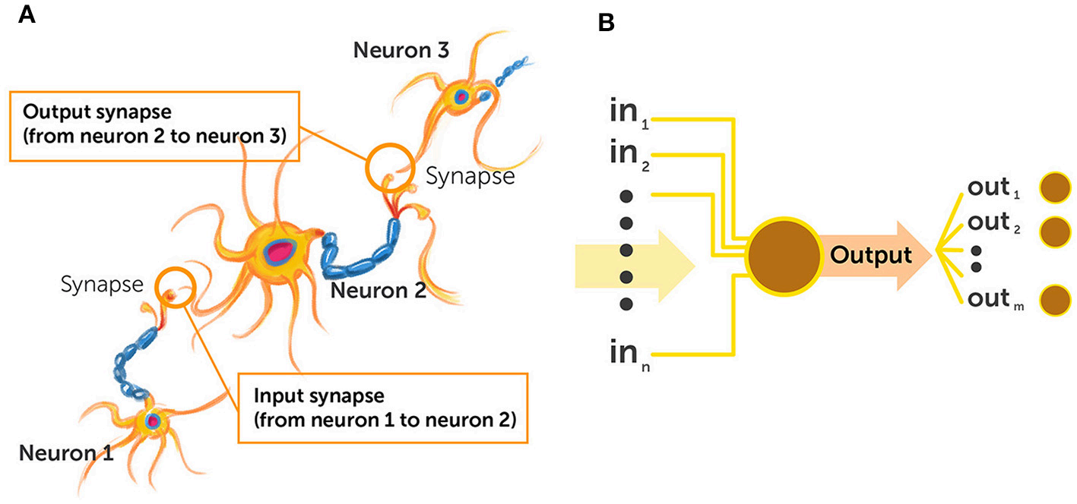
06
Brain VS Neural Network

Slide 3
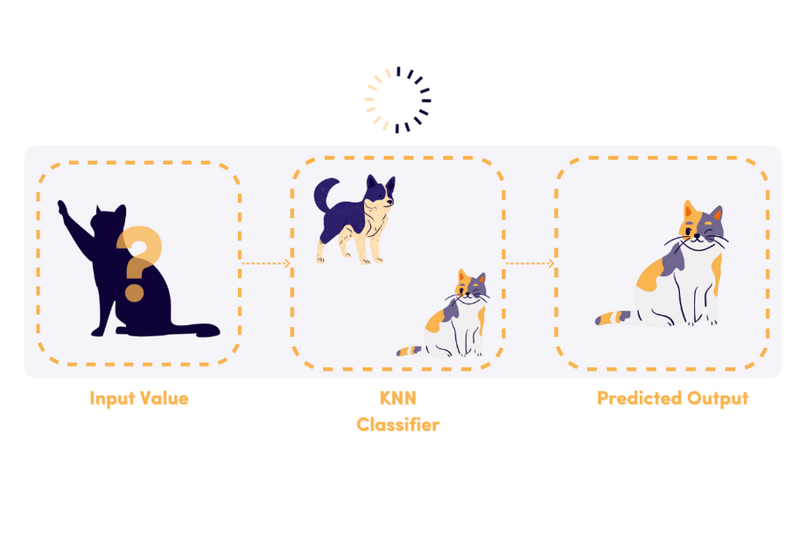
what is classifier
A classifier is an algorithm that sorts data into groups. It's a key tool in machine learning and data mining. The classifier looks at input data and puts it into one of several preset categories based on what it sees. Classifiers play a big role in supervised learning.
Thynk Unlimited
-
Project
06

Slide 4
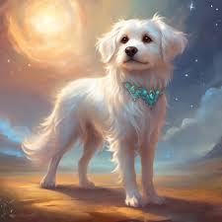

09
Forward
Propogation
Information flows from the input layer to the output layer iwhat is called forward propagation
Weights
Backward
Propogation
The common algorithm used for updating DNN weights is called
backpropagation

Slide 5
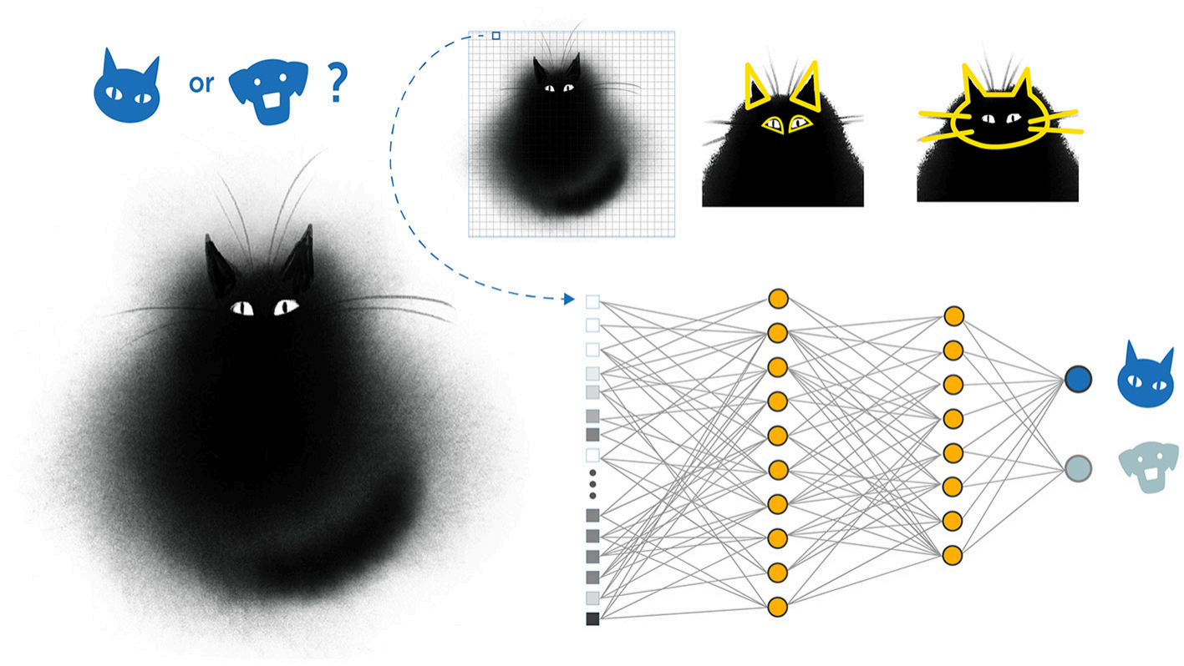
What is a classifier ?
Dog or Cat
PAPER PRESENTATION
-
12
ARTIFICAL INTELLIGENCE

Slide 6
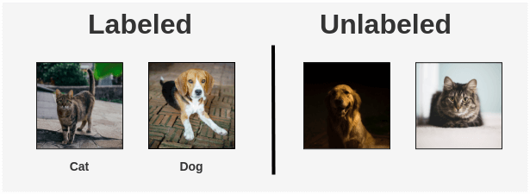
10
Supervised
The first is supervised
training, which is more accurate but less effcient, where systems scan many data samples already labeled by people
Types -
To Train
Self Supervised
The second way is self-supervised
training, where the network tries to reconstruct information it already
has (its input) after representing the information within its layers this
does not require human intervention.

Slide 7
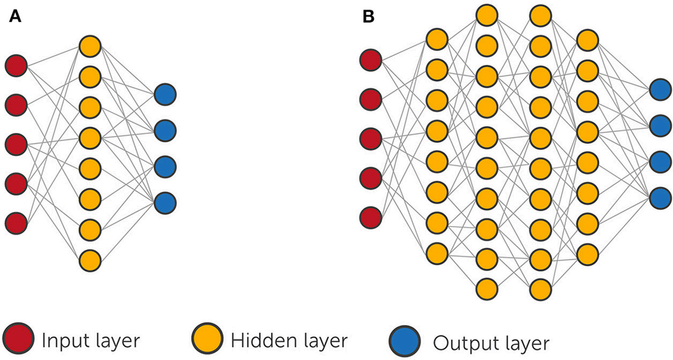
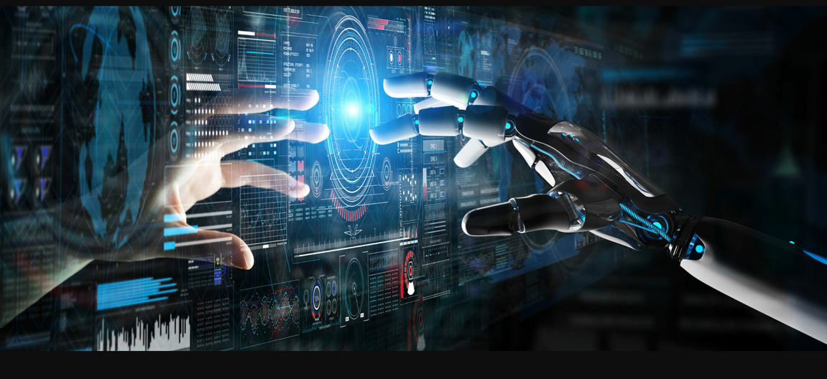
How chatgpt and gemini works
08
ChatGPT (OpenAI): Based on GPT-4 architecture, it’s a large language model using transformer neural networks. Trained on vast text data, it generates human-like responses. Uses deep learning to understand and predict context.
Gemini (Google DeepMind): Combines advanced language and multimodal capabilities (text + images). Designed for complex tasks like understanding visuals, code, and language. Optimized for efficiency and versatility across different AI applications.
Common Features: Both leverage pre-training (learning from large datasets) and fine-tuning (adjustments for specific tasks) to handle diverse user queries.

Slide 8
ARTIFICAL INTELLIGENCE
PAPER PRESENTATION
-
Syed. Abdul Azeez
Thank You

